Slide 1
An overview on Mesoscale Convective Systems and their forward motion
National Weather Service
Brian Squitieri, Ph.D.
Storm Prediction Center

Slide 2
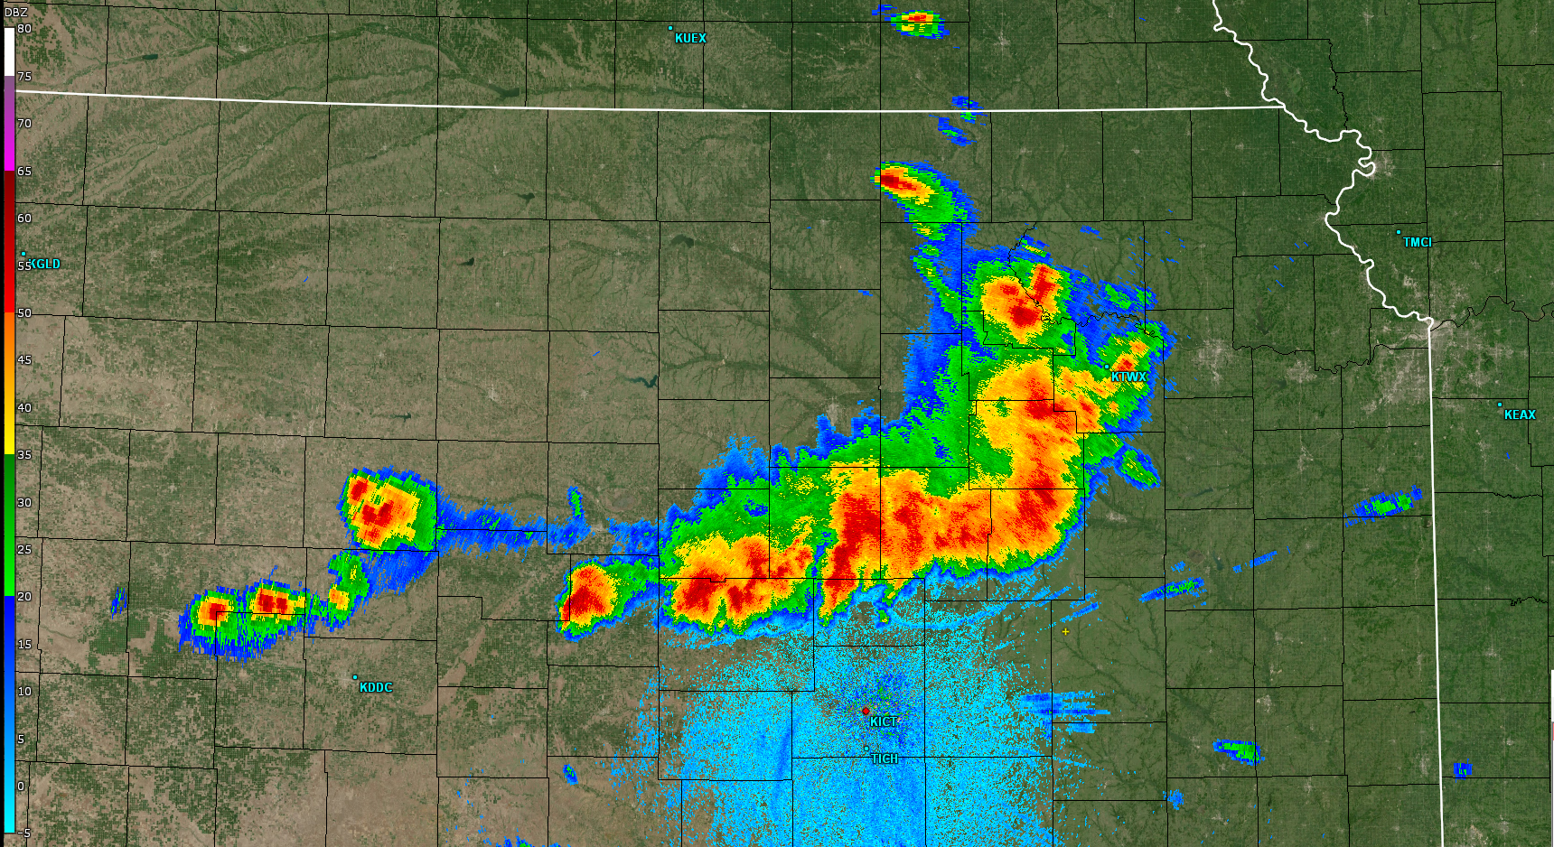
What is an MCS?
A Mesoscale Convective System (MCS) is “a cloud system that occurs in connection with an ensemble of thunderstorms and produces a contiguous precipitation area on the order of 100 km or more in horizontal scale in at least one direction” (AMS Glossary – 2025).
This definition can be applied liberally to any organized thunderstorm clusters that:
Is at least 100 km long
Lasts for at least 3 hours
Shares a common feature, such as a trailing precipitation region or cold pool.
MCSs may take on many forms, morphology and evolution
MCSs may be accompanied by all thunderstorm hazards:
Heavy rain and potential flooding
Frequent Lightning
Strong, damaging winds/gusts
Tornadoes
Hail

Slide 3
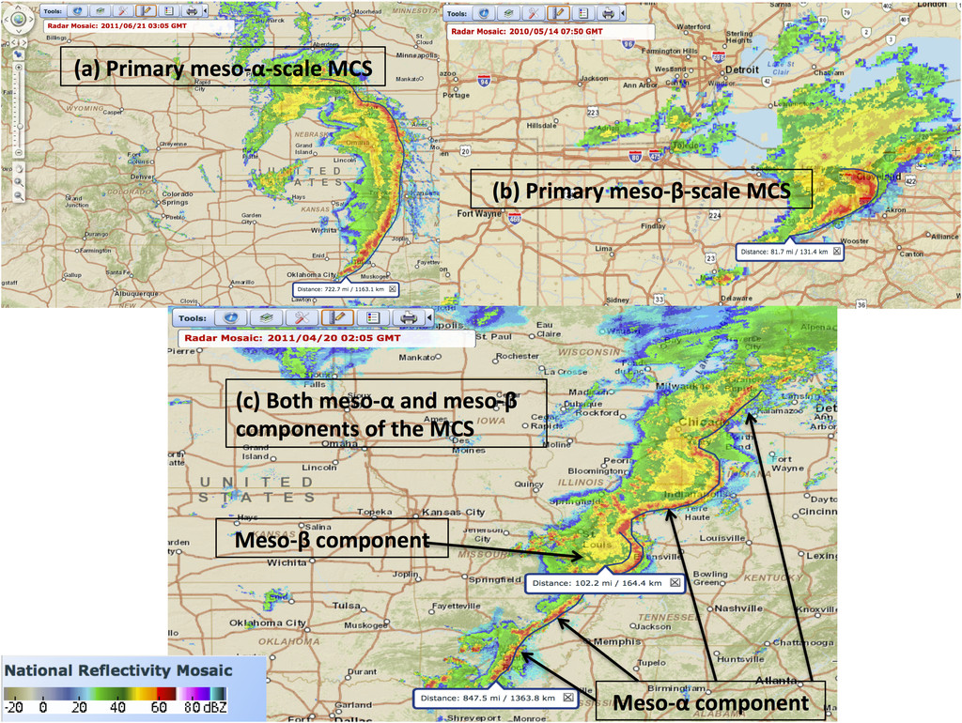
MCS Types
MCSs can be large, long-lived squall lines, or focused thunderstorm clusters.
Many past studies have developed a vast nomenclature to classify MCSs based on their structure and/or their morphology.
This lesson will focus primarily on weakly to modestly forced MCSs that tend to be predominantly self-organized and progressive.
Campbell et al. (2017)

Slide 4
MCSs on the spatial and temporal spectrum
x

Slide 5
MCSs on the spatial and temporal spectrum

Slide 6
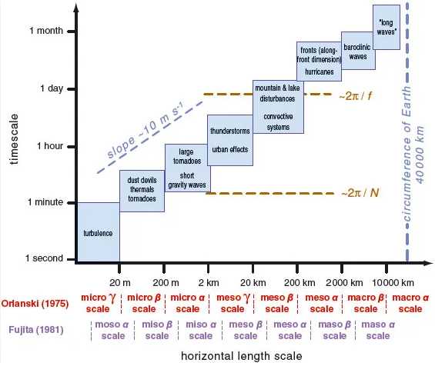
17 h
MCS scale
100 km, 3 h
10 min
L_{R} = Rossby radius of deformation
N = Brunt-Vaisala Frequency
H = Scale height of the atmosphere
f = Coriolis parameter

Slide 7
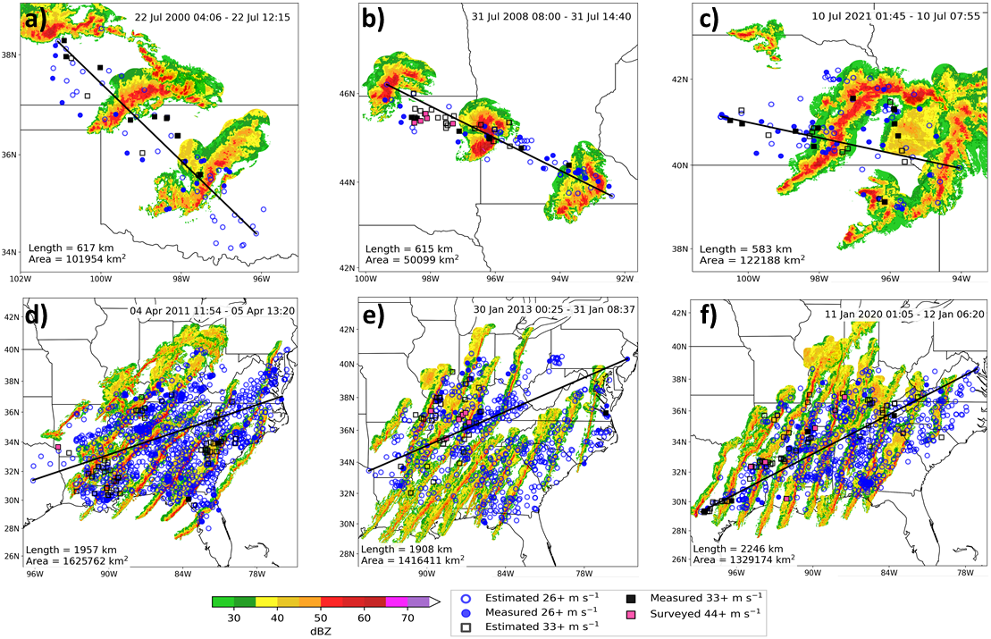
Cold-pool-driven MCSs tend to differ in structure from synoptically forced squall lines, with differences in wind swath attributes
8h 6h 6h
25h 32h 29h

Slide 8
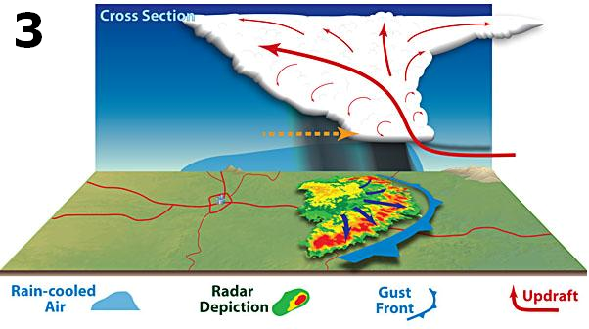
Secondary Upper Circulation
Secondary Lower Circulation
Forward Motion
Trailing Precipitation Region
MCS Leading Line

Slide 9
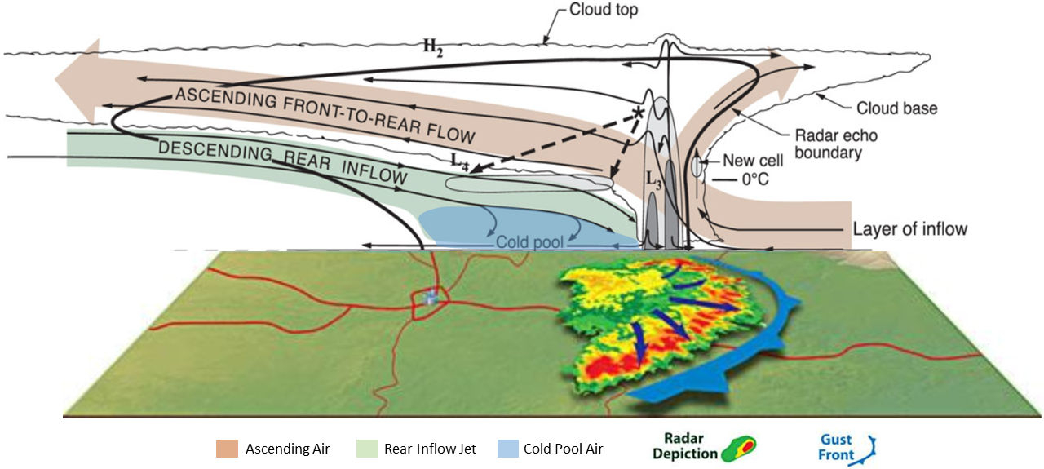

Slide 10
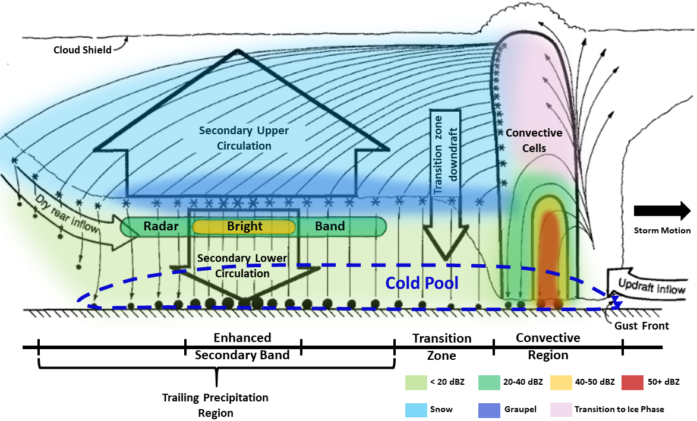

Slide 11
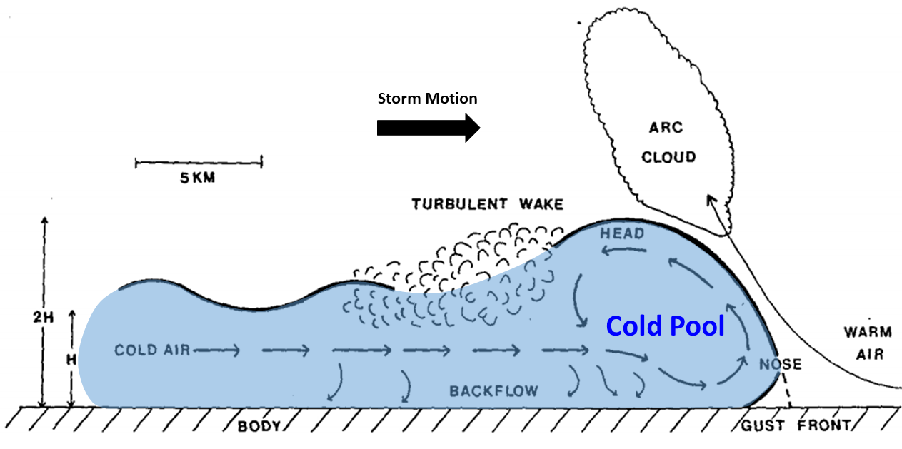

Slide 12
MCS Forward Motion
Johns and Hirt (1987) and Corfidi et al. (2016) both found that derechos move faster (sometimes much faster) than the full mean wind speed.
Derecho wind swaths are produced by thunderstorm clusters where either cold pool dynamics or other internal mechanisms dominate the processes that produce severe/destructive wind gusts.
Corfidi et al. (1996) and Corfidi (2003) devised a routine that can determine MCS forward motion based on the interaction between the cold pool and ambient flow fields.

Slide 13
MCS Forward Motion
MCS motion has 2 components (Advection and Propagation)
Advection: Component of motion involving cells being carried with or by the mean wind in the cloud layer (V_{CL}).
V_{CL}
Corfidi et al. (1996)

Slide 14
MCS Forward Motion
MCS motion has 2 components (Advection and Propagation)
Propagation: Component of motion due to the initiation of new cells driven by the convergence of storm relative inflow (V_{Prop}).
V_{-LLJ} = V_{Prop}
Cold Pool
LLJ
Direction of Propagation
Maximized
Convergence
Corfidi et al. (1996)

Slide 15
MCS Forward Motion
MCS motion has 2 components (Advection and Propagation)
The Advection and Propagation components are both additive.
V_{CL}
V_{Prop}
OR
V_{MCS}
Corfidi et al. (1996)

Slide 16
V_{MCS} Magnitude and Direction
We can find the speed and direction of the MCS motion vector using trigonometry.
However, these calculations are sensitive to the depth of the cloud layer of the mean wind, and the inflow layer available to the MCS, which can influence propagation.
V_{CL}
V_{Prop}
V_{MCS}
Corfidi et al. (1996)

Slide 17
What happens when we increase LLJ wind speeds?
V_{CL} = 50 kts
θ = 50 degrees (0.87 radians)
V_{MCS}?
𝜑?
50 kts
50ᵒ
50 kts
50ᵒ
50 kts
50ᵒ
50 kts
15 kts
50ᵒ
30 kts
45 kts
16ᵒ
37ᵒ
60 kts
59ᵒ
42 kts
76ᵒ
38 kts
40 kts
47 kts
Increasing LLJ wind speeds results in faster MCS propagation, which will contribute to an overall faster storm motion.
Given increased convergence in the direction of the negative LLJ, the MCS will propagate more toward the right.

Slide 18
What happens when we decrease mean wind speeds?
V_{PROP/LLJ} = 30 kts
θ = 50 degrees (0.87 radians)
V_{MCS}?
𝜑?
50ᵒ
60 kts
30 kts
45 kts
50ᵒ
30 kts
30 kts
50ᵒ
30 kts
15 kts
29ᵒ
42ᵒ
50ᵒ
65ᵒ
30 kts
47 kts
34 kts
79ᵒ
25 kts
23 kts
Decreasing mean wind speeds with a constant LLJ still lowers overall MCS forward speed (less of a deep-layer ambient environmental contribution to forward motion).
Decreasing mean wind speeds alone will increase the contribution the LLJ to MCS forward motion, which is why a constant LLJ will influence more rightward turning of an MCS as mean wind speeds decrease .

Slide 19
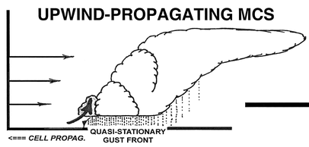
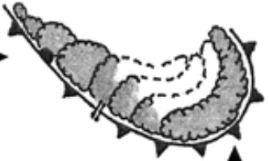
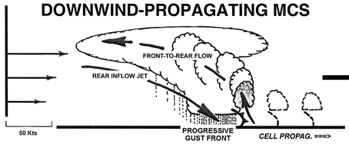
MCS Forward Motion
Not a straightforward relationship. MCS can propagate both upwind and downwind of the mean vertical wind field.
Corfidi et al. (1996) demonstrated how to account for upwind propagation. What about downwind propagation?
V_{Prop-Upwind}
V_{Prop-Downwind}?
V_{Prop}
50 kts
V_{Prop}
Corfidi (2003)

Slide 20
MCS Forward Motion Factors
The Corfidi et al. (1996) method only factors mean-wind and low-level wind/convergence-driven propagation influences.
What about the cold pool? Studies have shown that MCS forward speed is dependent on cold pool evolution (Charba 1974; Newton and Fankhauser 1975; Betts 1976; Miller and Betts 1977).
In reality, MCS forward motion is influenced by 3 factors: Mean Wind Speed - V_{CL}, Upwind (low-level-convergence-driven) propagation - V_{Prop-Upwind}, and Downwind (cold-pool-driven) propagation – V_{Prop-Downwind} (Corfidi 2003).
However, the Corfidi et al. (1996) V_{MCS} vector already takes into upwind propagation, so we can substitute this vector in as a component of MCS motion. Henceforth, we will call the ‘V_{MCS}’ vector ‘V_{upwind}’.

Slide 21
MCS Forward Motion Factors
Again, the components of MCS forward motion are additive, so we add VCL and V_{upwind} to get V_{downwind}. As such,
V_{Upwind}
V_{CL}
V_{CL}
V_{Prop}
becomes
V_{Downwind}
V_{MCS}
Where V_{MCS} = V_{Upwind}
Corfidi (2003)

Slide 22
MCS Forward Motion Factors
Downwind-propagating MCSs are dominated by the cold pool, and derechos are also produced by cold-pool-driven MCSs, which are dominated by internal forcing mechanisms.
As such, V_{downwind} would be a useful vector for monitoring derecho progression.
Note that V_{downwind} is a longer vector than V_{CL}.
V_{Upwind}
V_{CL}
V_{Downwind}

Slide 23
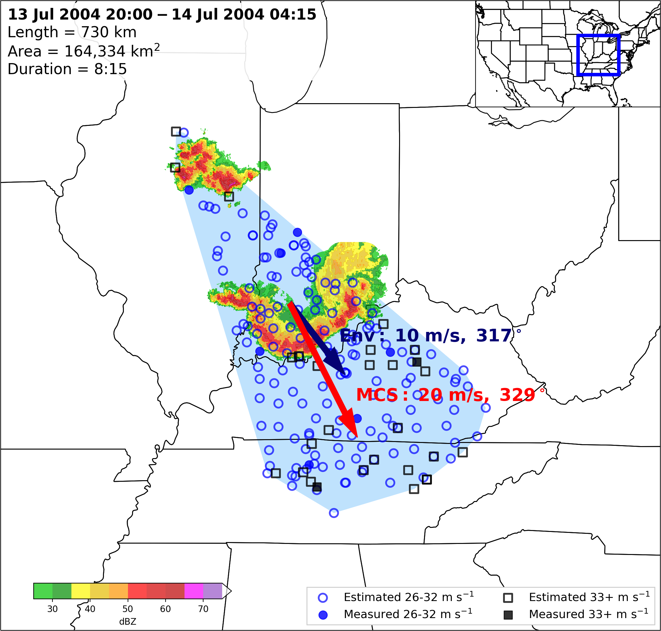
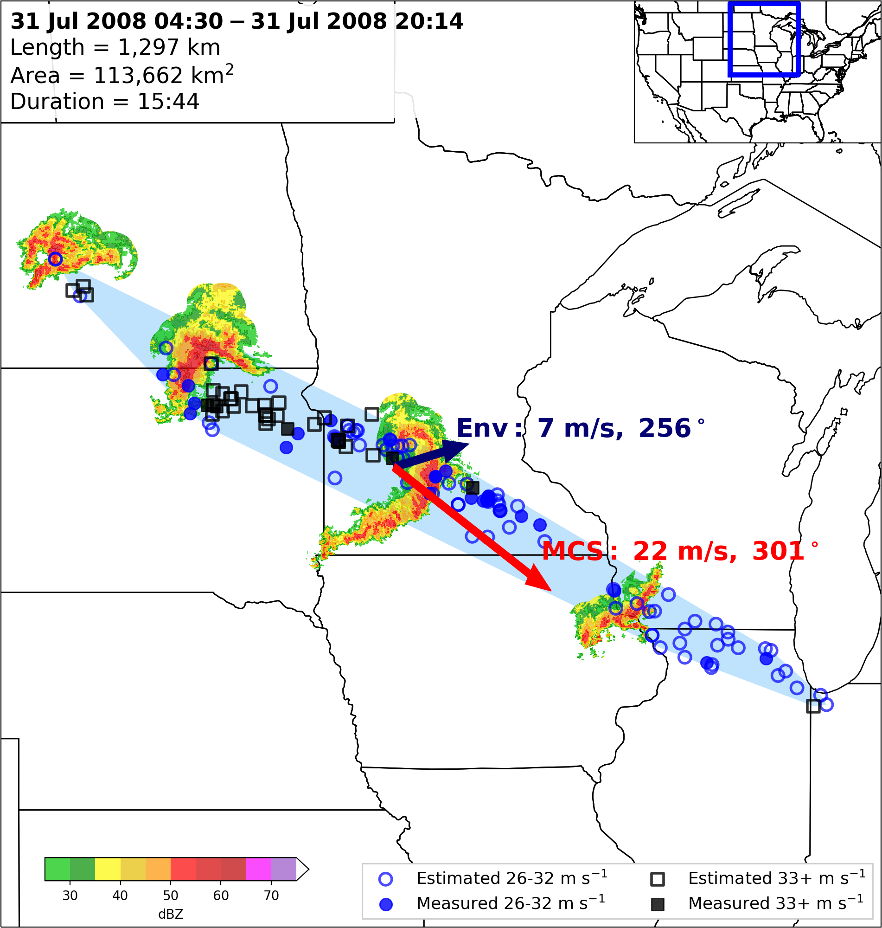
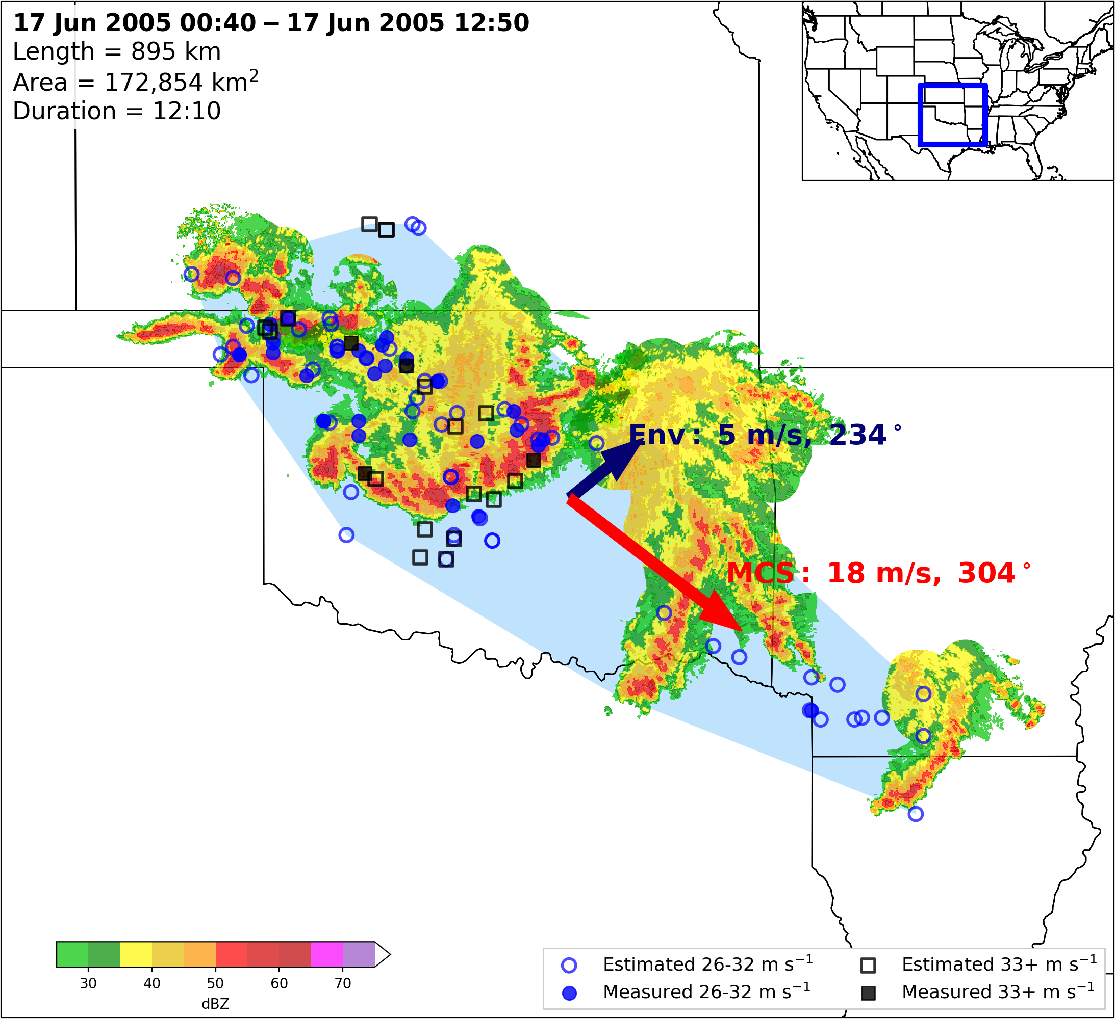
MCSs moving faster than the mean wind speed is an excellent discriminator between cold-pool-driven MCSs and their squall line counterparts.

Slide 24
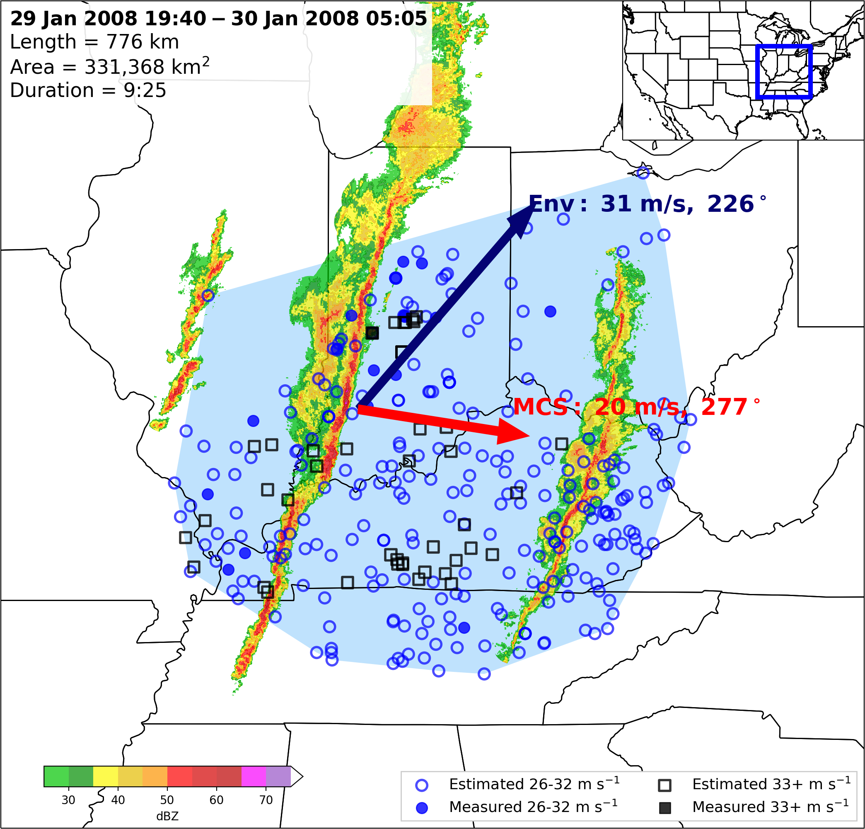
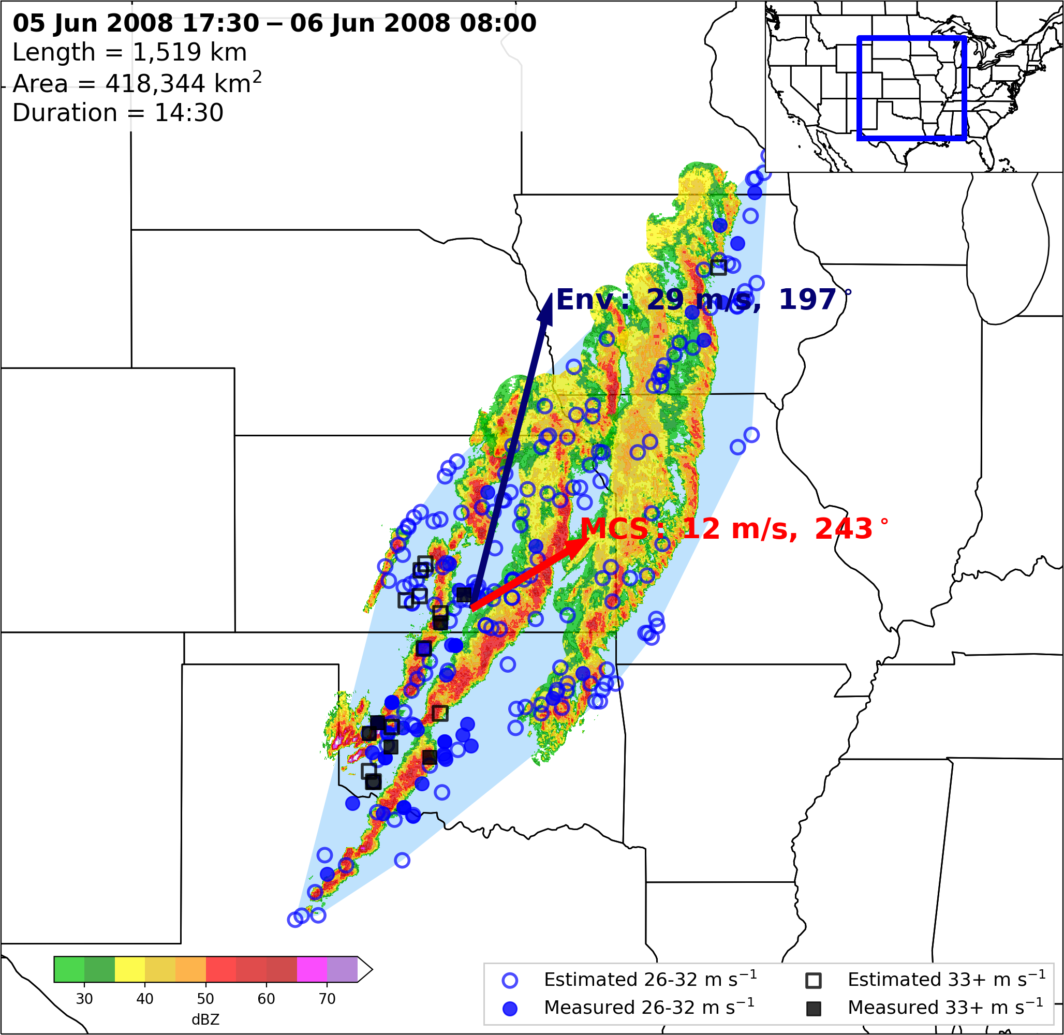
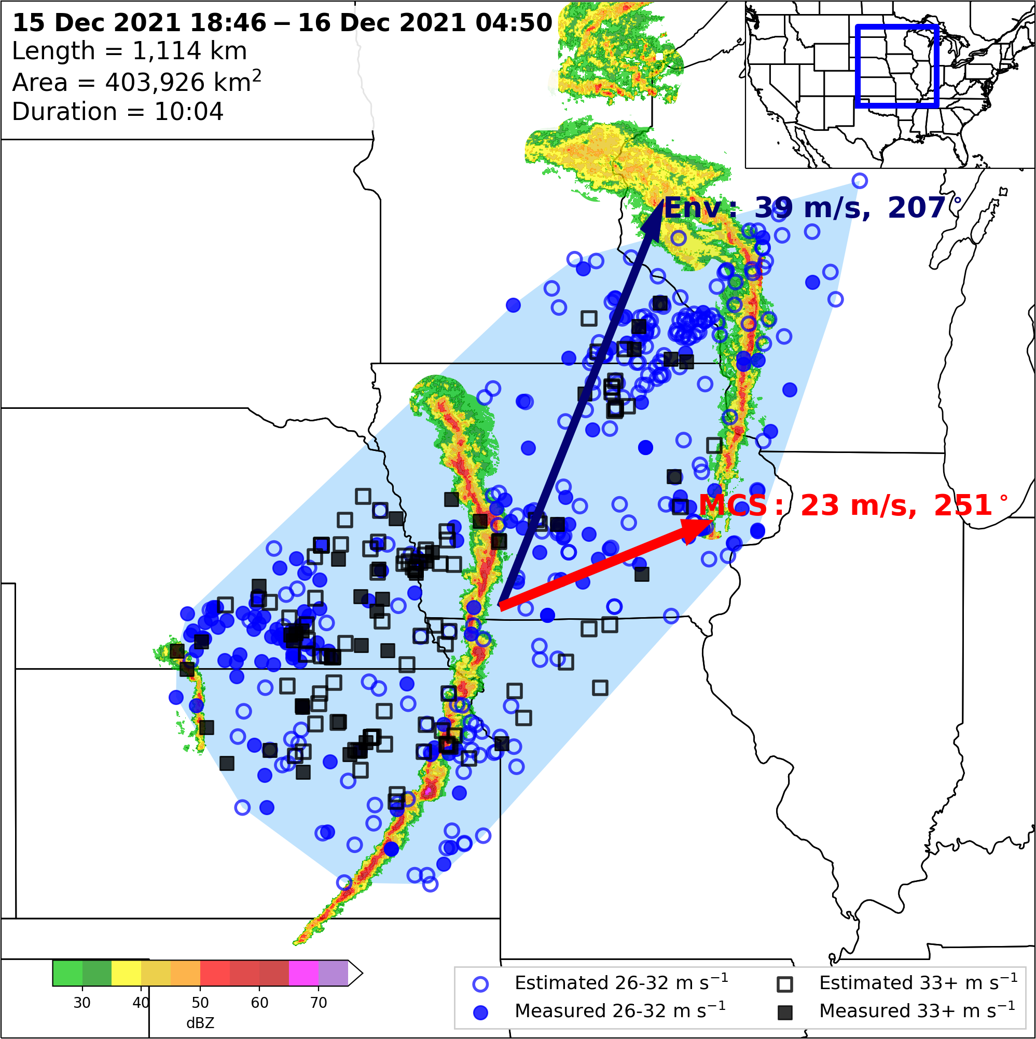
MCSs moving faster than the mean wind speed is an excellent discriminator between cold-pool-driven MCSs and their squall line counterparts.
Note: Cold-pool-driven MCSs and strongly forced squall lines both have degrees of internal and external forcing (i.e. a level of contribution from the cold pool
The argument is that to define derechos as a distinct phenomena, internal forcing mechanisms must dominate, which is defined by the MCS moving faster than the full mean wind speed.

Slide 25
References
Corfidi, S. F., 2003: Cold pools and MCS propagation: Forecasting the motion of downwind-developing MCSs. Wea. Forecasting, 18, 997–1017, https://doi.org/10.1175/1520-0434(2003)018<0997:CPAMPF>2.0.CO;2.
Corfidi, S. F., Merritt J. H. , and Fritsch J. M. , 1996: Predicting the movement of mesoscale convective complexes. Wea. Forecasting, 11 , 41–46. https://doi.org/10.1175/1520-0434(1996)011<0041:PTMOMC>2.0.CO;2.
Houze, R. A., 2018: 100 years of research on mesoscale convective systems. A Century of Progress in Atmospheric and Related Sciences: Celebrating the American Meteorological Society Centennial, Meteor. Monogr., No. 59, Amer. Meteor. Soc., https://doi.org/10.1175/AMSMONOGRAPHS-D-18-0001.1.
Parker, M. D., and R. H. Johnson, 2000: Organizational modes of midlatitude mesoscale convective systems. Mon. Wea. Rev., 128, 3413–3436, https://doi.org/10.1175/1520-0493(2001)129<3413:OMOMMC>2.0.CO;2.

